Slide 1


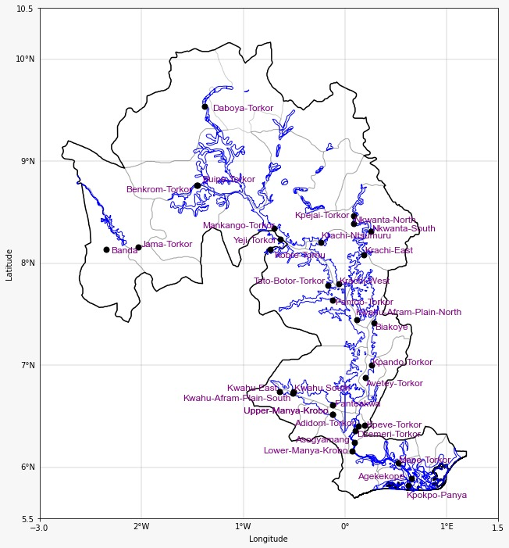

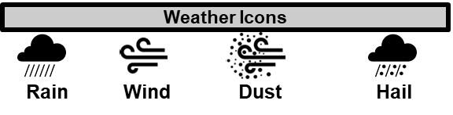
GHANA METEOROLOGICAL AGENCY
P. O. Box LG 87, Accra
Tel: +233-302-543252 / 307010019
Digital Address: GA-485-3581
Email: info@meteo.gov.gh
Website: www.meteo.gov.gh
Twitter:@GhanaMet
Facebook: Ghana Meteorological Agency (GMet)
INLAND WATER IMPACT-BASED FORECAST
WEATHER SUMMARY
The lake and its environs are anticipated to stay overcast tonight, with a 30% chance of light to moderate rain or intermittent drizzle, with or without thunderstorms. It is forecast that the morning will be partly cloudy in the northern sector and variably cloudy in the middle and southern sectors.
EVENING (23/06/2026) | MORNING (24/06/2026) | AFTERNOON (24/06/2026)
A
A
Date
23/06/2026
Time Issued
4:00 PM
Valid From
06:00 PM
Nowcasting Risk
Take Action
Be aware
Low risk
No risk
Time | Surface Wind | Visibility | Temperature
12 hours | S/SE 05 Max 18 kt | (4 – 9) km | (23 – 32) ºC
24 hours | S/SW 05 Max 18 kt | (4 – 10) km | (22 – 33) ºC

