Slide 1


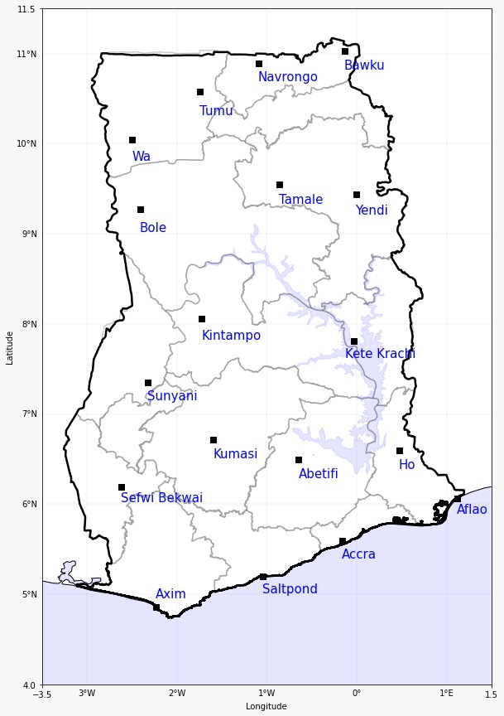
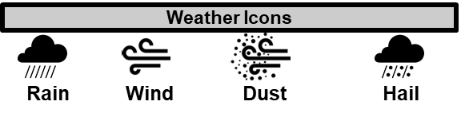
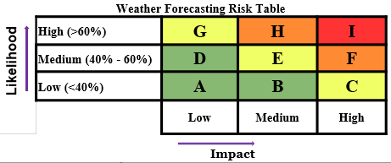

GHANA METEOROLOGICAL AGENCY
GHANA METEOROLOGICAL AGENCY
Email: info@meteo.gov.gh
Website: www.meteo.gov.gh
Twitter:@GhanaMet
Facebook: Ghana Meteorological Agency (GMet)
P. O. Box LG 87, Accra
Tel: +233-302-543252 / 307010019
Digital Address: GA-485-3581
Email: info@meteo.gov.gh
Website: www.meteo.gov.gh
Twitter:@GhanaMet
Facebook: Ghana Meteorological Agency (GMet)
P. O. Box LG 87, Accra
Tel: +233-302-543252 / 307010019
Digital Address: GA-485-3581
24-HOUR IMPACT-BASED FORECAST FOR GHANA
MORNING (30/01/2025) | AFTERNOON (30/01/2025) | EVENING (30/01/2025) | CAFO
 |  |  | Date
 |  |  | 30-Jan-25
 |  |  | Time Issued
 |  |  | 0500 UTC
 |  |  | Valid From
 |  |  | 0600 UTC
 |  |  | Nowcasting Risk
 |  |  | Take Action
 |  |  | Be Prepared
 |  |  | Be aware
 |  |  | Low risk
 |  |  | No risk
E
E
H
E
E
E
E
E
E
E
E
E
D
D
D
A
A
D
A
Mist
Sector | Minimum Temperature (ºC) | Maximum Temperature (ºC)
Coast | 24 | 34
Forest | 24 | 36
Transition | 21 | 37
Northern | 20 | 37
SUMMARY: Southern Ghana will largely experience misty conditions with patches of fog early this morning, while the northern regions will remain dry and hazy throughout the forecast period. However, sunny intervals are expected over the south during the afternoon hours, with chances of localized thundery showers of varying intensity in parts of the coast and inland areas. Visibility across the country is projected to range between 500 meters and 8000 meters.
CAUTION!
Naked fires should be handled cautiously to prevent any form of fire outbreak due to the dryness in some parts of the country.
Motorists are advised to use fog lights and drive within appropriate speed limits due to deteriorated visibility.
SIGNED: Central Analysis and Forecasting Office (CAFO)

