Slide 1


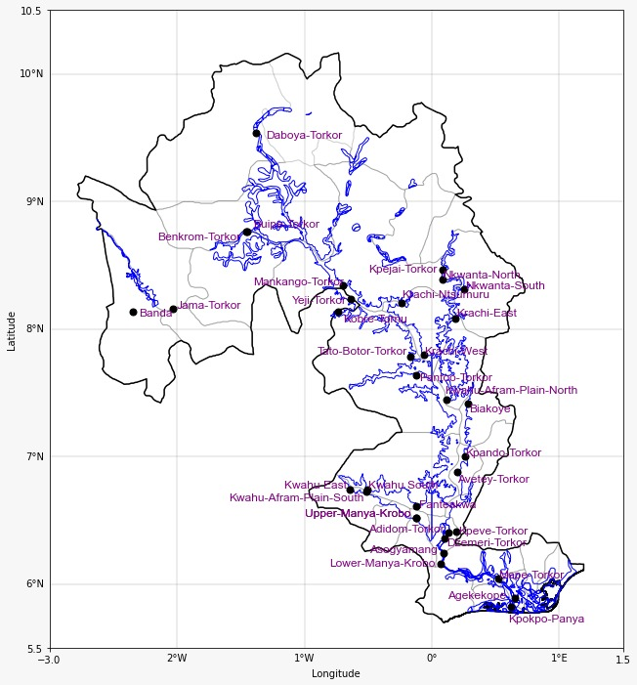

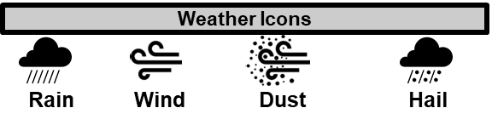
GHANA METEOROLOGICAL AGENCY
P. O. Box LG 87, Accra
Tel: +233-302-543252 / 307010019
Digital Address: GA-485-3581
Email: info@meteo.gov.gh
Website: www.meteo.gov.gh
Twitter:@GhanaMet
Facebook: Ghana Meteorological Agency (GMet)
INLAND WATER IMPACT-BASED FORECAST
WEATHER SUMMARY
The lake and its environs are expected to experience varying degrees of cloud cover with rain showers in some portions of the southern and middle sectors tonight. However, there is a 40% chance of scattered slight to moderate rain in the southern, middle and some portions of the northern sector during the morning hours.
EVENING (06/08/2025) | MORNING (07/08/2025) | AFTERNOON (07/08/2025)
D
A
Date
06/08/2025
Time Issued
4:00 PM
Valid From
06:00 PM
Nowcasting Risk
Take Action
Be aware
Low risk
No risk
Time | Surface Wind | Visibility | Temperature
24 hours | S/SW 05 Max 18 kt | (4 – 10) km | (21 – 28) ºC
48 hours | S/SW 05 Max 20 kt | (4 – 10) km | (21 – 28) ºC

