Slide 1


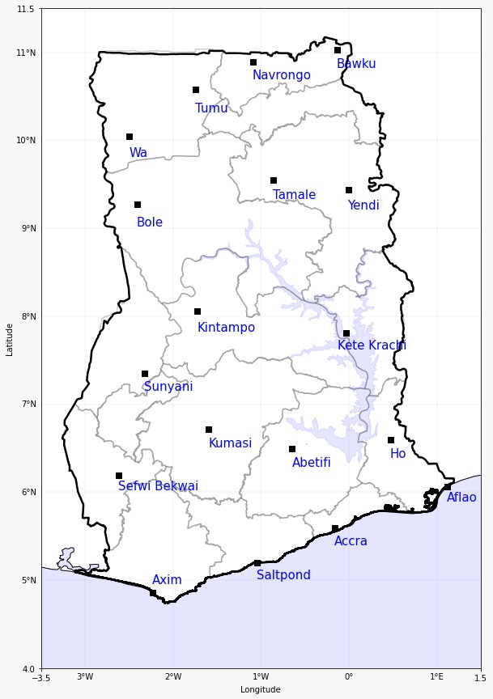

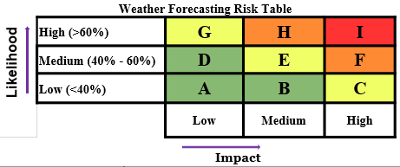
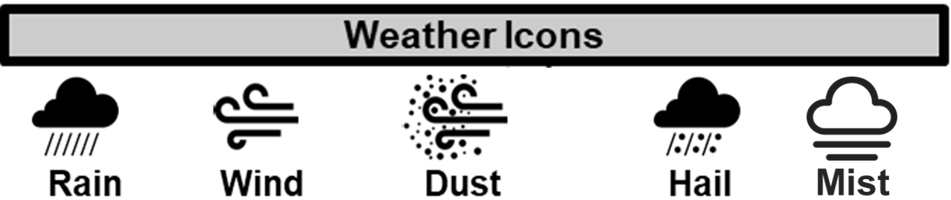
GHANA METEOROLOGICAL AGENCY
GHANA METEOROLOGICAL AGENCY
Email: info@meteo.gov.gh
Website: www.meteo.gov.gh
Twitter:@GhanaMet
Facebook: Ghana Meteorological Agency (GMet)
P. O. Box LG 87, Accra
Tel: +233-302-543252 / 307010019
Digital Address: GA-485-3581
Email: info@meteo.gov.gh
Website: www.meteo.gov.gh
Twitter:@GhanaMet
Facebook: Ghana Meteorological Agency (GMet)
P. O. Box LG 87, Accra
Tel: +233-302-543252 / 307010019
Digital Address: GA-485-3581
IMPACT-BASED FORECAST FOR GHANA (MIDWEEK)
TONIGHT (20/08/2025) | THURSDAY (21/08/2025) | FRIDAY (22/08/2025) | CAFO
 |  |  | Date
 |  |  | 20/08/2025 TO 22/08/2025
 |  |  | Time Issued
 |  |  | 1700 UTC
 |  |  | Valid From
 |  |  | 1800 UTC
 |  |  | Nowcasting Risk
 |  |  | Take Action
 |  |  | Be Prepared
 |  |  | Be aware
 |  |  | Low risk
 |  |  | No risk
A
E
E
E
E
A
G
G
D
A
D
G
G
A
A
D
D
A
SECTORS | TONIGHT | THURSDAY | FRIDAY
COASTLINE | Mostly Cloudy Slight Rain/Drizzle | Early Morning Mist Mostly Cloudy Intermittent Slight Rain/Drizzle | Early Morning Mist Mostly Cloudy Intermittent Rain/Drizzle
SLIGHTLY NORTH OF COASTLINE | Mostly Cloudy Slight Rain/Drizzle | Early Morning Mist/Fog Patches Mostly Cloudy Intermittent Slight Rain/Drizzle | Early Morning Mist/Fog Patches Mostly Cloudy Intermittent Rain/Drizzle
MIDDLE | Mostly Cloudy Slight Rain/Drizzle | Early Morning Mist/Fog Patches Mostly Cloudy Intermittent Slight Rain/Drizzle | Early Morning Mist/Fog Patches Mostly Cloudy Intermittent Rain/Drizzle
TRANSITION | Mostly Cloudy Slight Rain/Drizzle | Early Morning Mist/Fog Patches Mostly Cloudy Intermittent Rain/Drizzle | Early Morning Mist/Fog Patches Mostly Cloudy Intermittent Slight Rain/Drizzle
NORTHERN | Mostly Cloudy Isolated Thunderstorms/Rain | Mostly Cloudy Scattered Thunderstorms/Rain | Mostly Cloudy Scattered Thunderstorms/Rain

