Slide 1
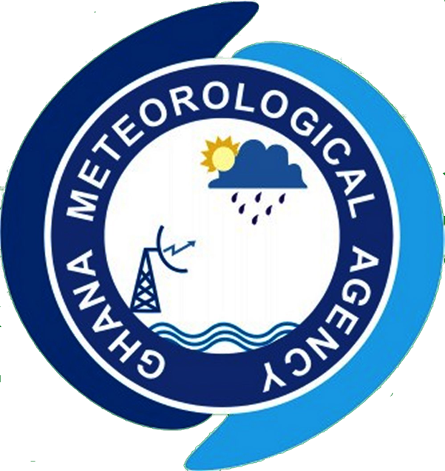

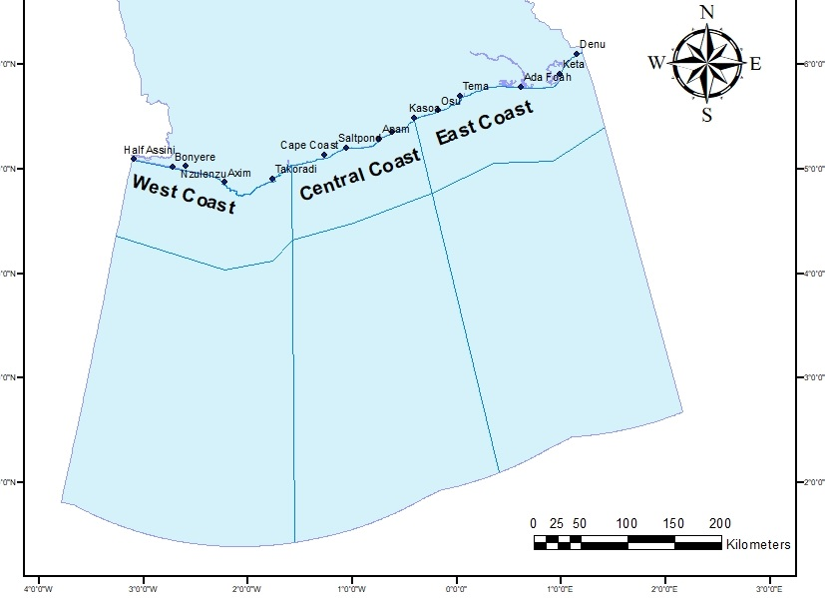
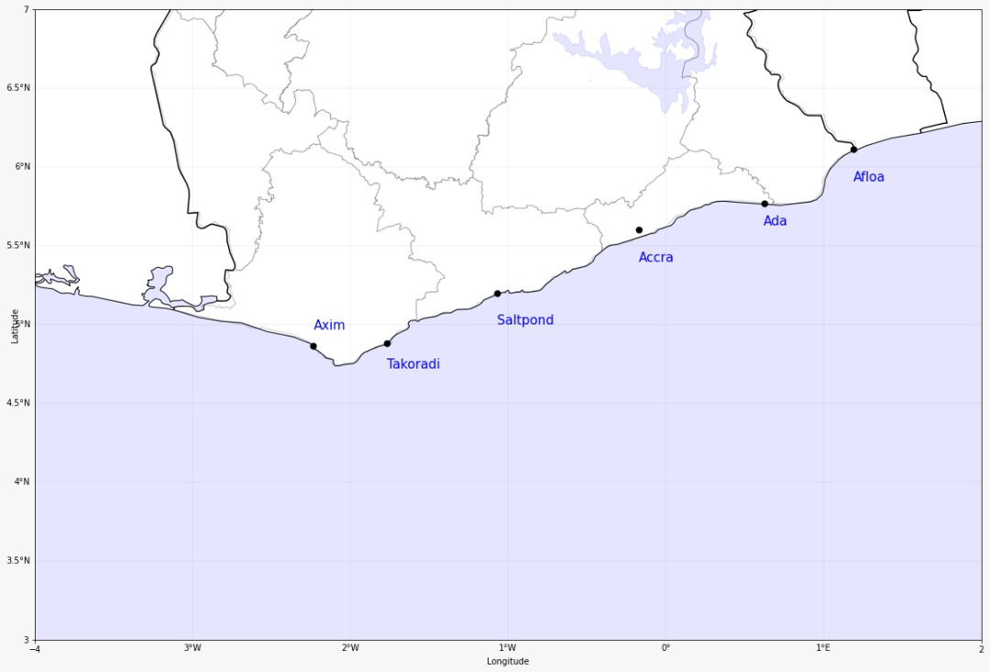

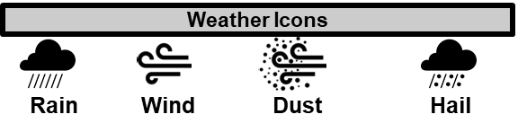

GHANA METEOROLOGICAL AGENCY
P. O. Box LG 87, Accra
Tel: +233-302-543252 / 307010019
Digital Address: GA-485-3581
Email: info@meteo.gov.gh
Website: www.meteo.gov.gh
Twitter:@GhanaMet
Facebook: Ghana Meteorological Agency (GMet)
COASTAL & MARITIME FORECAST FOR GHANA
IMPACT-BASED FORECAST
VALID AT 1200Z 02/10/2025
Date Issued
02/10/2025
Time Issued
10:00 AM
Valid From
12:00 PM
Nowcasting Risk
Take Action
Be aware
Low risk
No risk
A
A
D
D
D
D
State of the Sea:
Time | Surface Wind | Visibility | Sea Surface Temperature | Sig. Wave Height | Tide | Wave Current (m/s)
12 hours | S/SW 05KT MAX 20KT | (4 – 10) km | (24 – 28) ºC | (1.4 – 1.8) Meters | (0.54– 1.25) Meters | Average: E/NE 0.51m/s Max (0.55 – 0.70)
24 hours | S/SW 05KT MAX 15KT | (5– 10) km | (24 – 28) ºC | (1.2– 1.8) Meters | (0.68 – 1.44) Meters | Average: E/NE 0.55 m/s Max (0.69 – 0.73)
WEATHER SUMMARY: Mostly cloudy conditions will be experienced over the maritime of our country this afternoon through to the evening with a 40% likelihood of slight to moderate rains over the west coast and areas offshore and a 30% over the east and the central coast.
WEATHER SUMMARY:
SIGNED: Ghana Meteorological Agency, Marine Forecast Office, Accra

