Slide 1
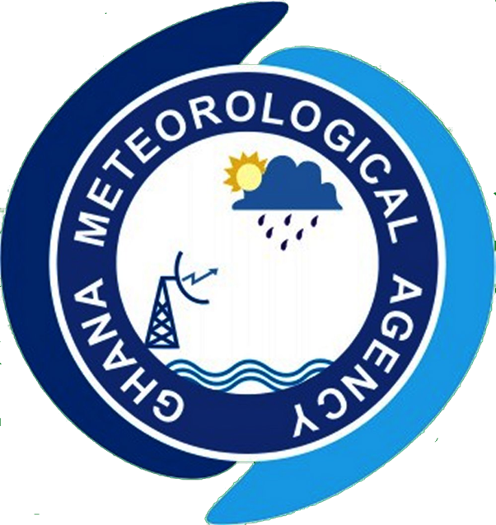

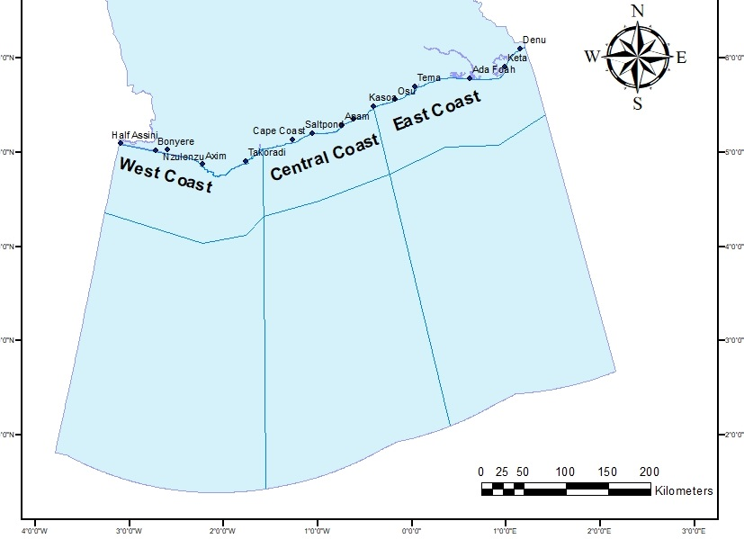
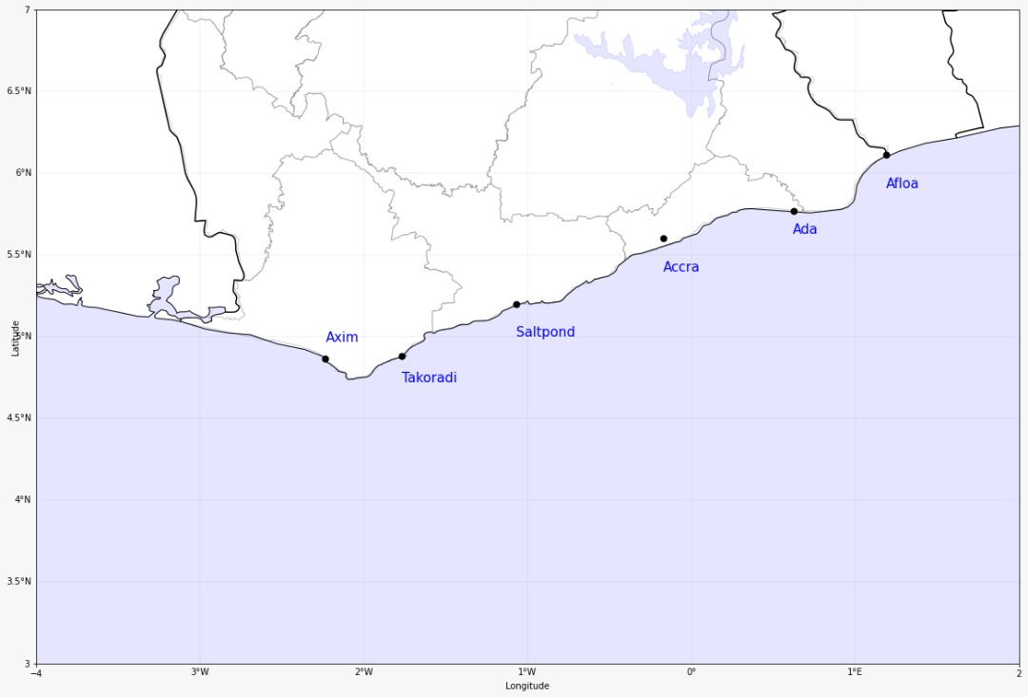

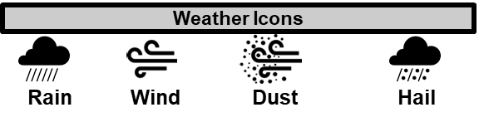

GHANA METEOROLOGICAL AGENCY
P. O. Box LG 87, Accra
Tel: +233-302-543252 / 307010019
Digital Address: GA-485-3581
Email: info@meteo.gov.gh
Website: www.meteo.gov.gh
Twitter:@GhanaMet
Facebook: Ghana Meteorological Agency (GMet)
COASTAL & MARITIME FORECAST FOR GHANA
IMPACT-BASED FORECAST
VALID AT 1200Z 07/10/2025
Date Issued
07/10/2025
Time Issued
10:00 AM
Valid From
12:00 PM
Nowcasting Risk
Take Action
Be aware
Low risk
No risk
E
E
D
State of the Sea:
Time | Surface Wind | Visibility | Sea Surface Temperature | Sig. Wave Height | Tide | Wave Current (m/s)
12 hours | S/SW 07KT MAX 15KT | (4 – 10) km | (24 – 28) ºC | (1.1 – 1.7) Meters | (0.12 – 1.94) Meters | Average: E/NE 0.64m/s Max (0.74 – 0.84)
24 hours | S/SW 08KT MAX 15KT | (4 – 10) km | (24 – 28) ºC | (1.1 – 1.9) Meters | (0.11 – 1.92) Meters | Average: E/NE 0.57 m/s Max (0.61 – 0.77)
WEATHER SUMMARY: Over the course of the forecast period, Ghana's marine space will continue to see variable cloud cover. However, there is a 60% chance of sporadic light to moderate rainfall in both coastline and offshore between the afternoon and evening hours.
WEATHER SUMMARY:
SIGNED: Ghana Meteorological Agency, Marine Forecast Office, Accra

