Slide 1


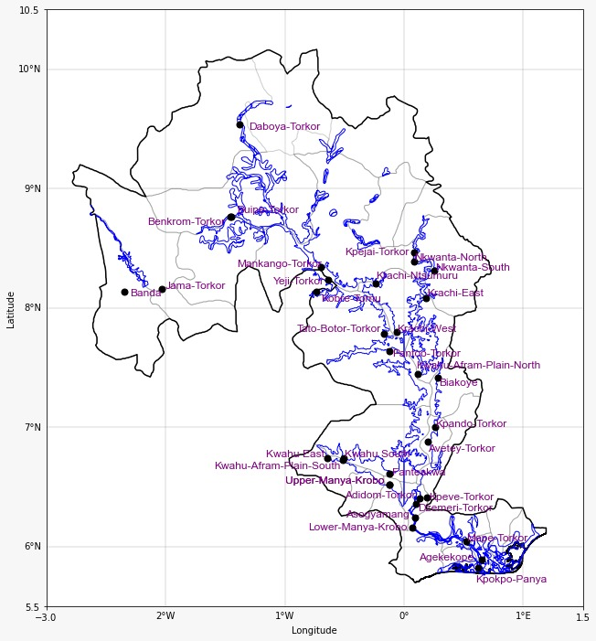

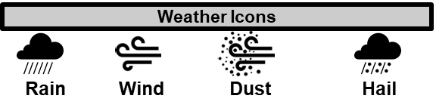
GHANA METEOROLOGICAL AGENCY
P. O. Box LG 87, Accra
Tel: +233-302-543252 / 307010019
Digital Address: GA-485-3581
Email: info@meteo.gov.gh
Website: www.meteo.gov.gh
Twitter:@GhanaMet
Facebook: Ghana Meteorological Agency (GMet)
INLAND WATER IMPACT-BASED FORECAST
WEATHER SUMMARY
Clouds of varying intensity are expected to dominate the skies over the lake and its environs tonight, with isolated cases of light rains and cool breeze, south of the lake. The morning will be welcomed with misty and/or foggy weather over most areas near the lake, becoming sunny in the afternoon.
EVENING (03/12/2025) | MORNING (04/12/2025) | AFTERNOON (04/12/2025)
A
A
Date
03/12/2025
Time Issued
4:00 PM
Valid From
06:00 PM
Nowcasting Risk
Take Action
Be aware
Low risk
No risk
Time | Surface Wind | Visibility | Temperature
12 hours | S/SW 05 Max 23 kt | (4 – 10) km | (24 – 32) ºC
24 hours | S/SW 05 Max 18 kt | (5 – 10) km | (25 – 36) ºC

