Slide 1


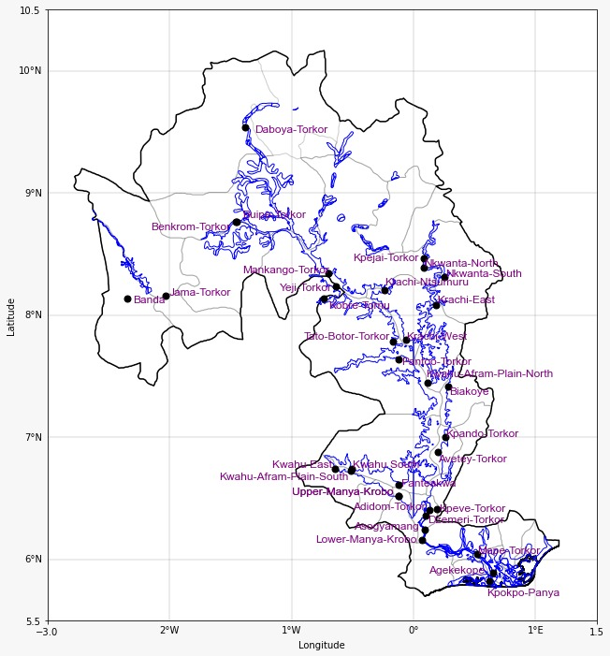




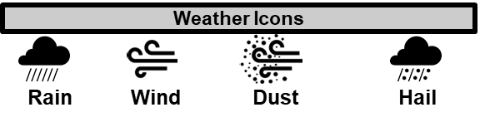
GHANA METEOROLOGICAL AGENCY
P. O. Box LG 87, Accra
Tel: +233-302-543252 / 307010019
Digital Address: GA-485-3581
Email: info@meteo.gov.gh
Website: www.meteo.gov.gh
Twitter:@GhanaMet
Facebook: Ghana Meteorological Agency (GMet)
INLAND WATER IMPACT-BASED FORECAST
WEATHER SUMMARY
The evening weather is expected to be partly cloudy around the lake and its nearby communities, with isolated light to moderate rain and thunderstorms in some areas of the southern sector. In contrast, the northern parts of the lake and surrounding areas will likely remain fairly dry with some haze.
EVENING (21/12/2025) | MORNING (22/12/2025) | AFTERNOON (22/12/2025)
Date
21/12/2025
Time Issued
4:00 PM
Valid From
06:00 PM
Nowcasting Risk
Take Action
Be aware
Low risk
No risk
Time | Surface Wind | Visibility | Temperature
12 hours | S/SE 05 Max 15 kt | (5 – 10) km | (22 – 31) ºC
24 hours | S/SE 05 Max 16 kt | (4 – 10) km | (23 – 33) ºC

