Slide 1


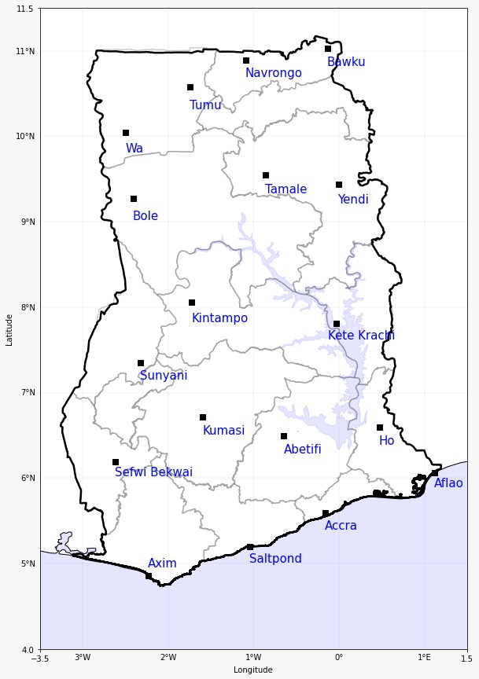
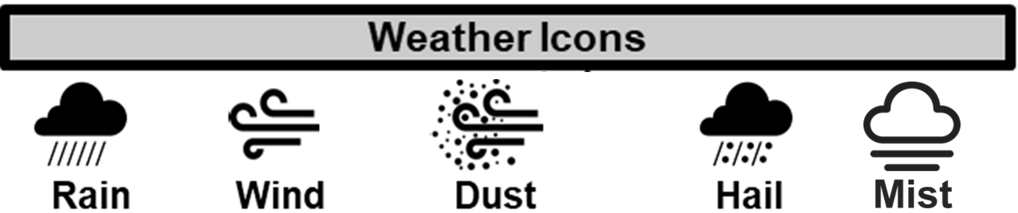

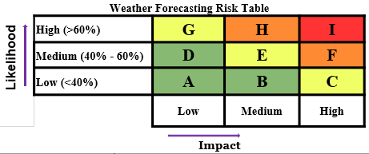
GHANA METEorOLOGICAL AGENCY
GHANA METEOROLOGICAL AGENCY
Email: info@meteo.gov.gh
Website: www.meteo.gov.gh
Twitter:@GhanaMet
Facebook: Ghana Meteorological Agency (GMet)
P. O. Box LG 87, Accra
Tel: +233-302-543252 / 307010019
Digital Address: GA-485-3581
Email: info@meteo.gov.gh
Website: www.meteo.gov.gh
Twitter:@GhanaMet
Facebook: Ghana Meteorological Agency (GMet)
P. O. Box LG 87, Accra
Tel: +233-302-543252 / 307010019
Digital Address: GA-485-3581
IMPACT-BASED FORECAST FOR GHANA (WEEKLY)
24HRS | MIDWEEK | WEEKEND | CAFO
 |  |  | Date
 |  |  | 22/12/2025 TO 28/12/2025
 |  |  | Time Issued
 |  |  | 1700 UTC
 |  |  | Valid From
 |  |  | 1800 UTC
 |  |  | Nowcasting Risk
 |  |  | Take Action
 |  |  | Be Prepared
 |  |  | Be aware
 |  |  | Low risk
 |  |  | No risk
E
D
D
D
D
D
D
E
E
E
E
D
E
D
SECTORS | 24 HOURS | MIDWEEK | WEEKEND
COASTLINE | Early Morning Mist Sunny Intervals Localised Thunderstorms/Rain | Early Morning Mist Sunny Intervals Localised Thunderstorms/Rain | Early Morning Mist Sunny Intervals Localised Thunderstorms/Rain
SLIGHTLY NORTH OF THE COASTLINE | Early Morning Mist/Fog Patches Sunny Intervals Localised Thunderstorms/Rain | Early Morning Mist/Fog Patches Sunny Intervals Localised Thunderstorms/Rain | Early Morning Mist/Fog Patches Sunny Intervals Localised Thunderstorms/Rain
MIDDLE | Early Morning Mist/Fog Patches Sunny Intervals Localised Thunderstorms/Rain | Early Morning Mist/Fog Patches Sunny Intervals Localised Thunderstorms/Rain | Early Morning Mist/Fog Patches Sunny Intervals Localised Thunderstorms/Rain
TRANSITION | Early Morning Mist/Fog Patches Sunny Periods | Early Morning Mist/Fog Patches Sunny Periods Localised Thunderstorms/Rain | Early Morning Mist/Fog Patches Sunny Periods Localised Thunderstorms/Rain
NORTH | Fairly Dry & Slightly Hazy Sunny Periods Few Clouds | Early Morning Mist (Savannah Region Sunny Periods Fairly Dry & Slightly Hazy | Early Morning Mist (Savannah Region) Fairly Dry & Slightly Hazy Sunny Periods Localised Thunderstorms/Rain

