Slide 1
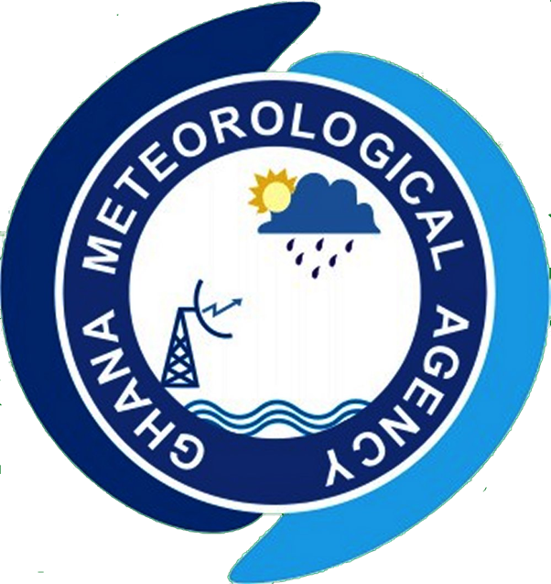

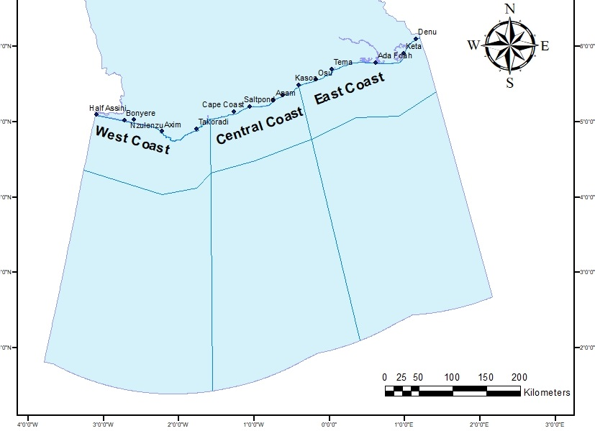
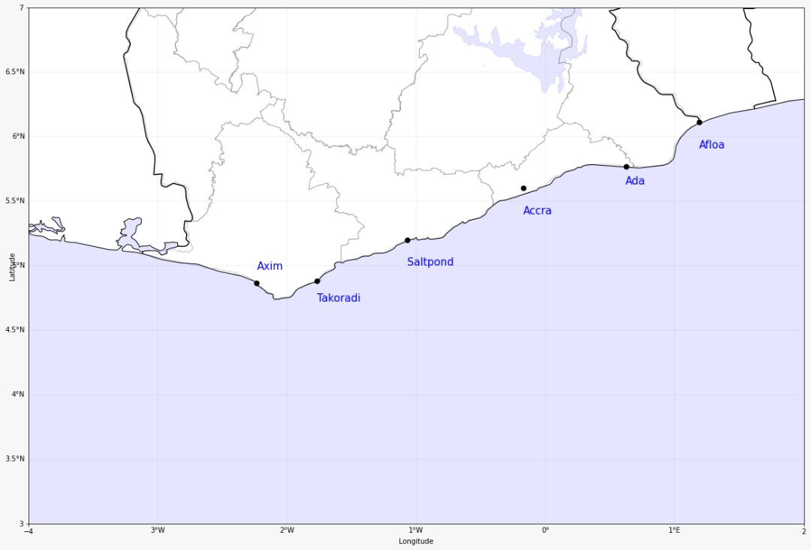

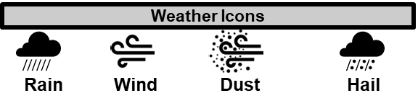

GHANA METEOROLOGICAL AGENCY
P. O. Box LG 87, Accra
Tel: +233-302-543252 / 307010019
Digital Address: GA-485-3581
Email: info@meteo.gov.gh
Website: www.meteo.gov.gh
Twitter:@GhanaMet
Facebook: Ghana Meteorological Agency (GMet)
COASTAL & MARITIME FORECAST FOR GHANA
IMPACT-BASED FORECAST
VALID AT 0000Z 03/02/2026
Date Issued
02/02/2026
Time Issued
4:00 PM
Valid From
12:00 AM
Nowcasting Risk
Take Action
Be aware
Low risk
No risk
D
A
D
D
D
D
State of the Sea:
Time | Surface Wind | Visibility | Sea Surface Temperature | Sig. Wave Height | Tide | Wave Current (m/s)
12 hours | S/SW 05KT MAX 16KT | (4 – 10) km | (27 – 30) ºC | (1.0 – 1.5) Meters | (0.11 – 1.64) Meters | Average: E/NE 0.60m/s Max (0.73 – 0.90)
24 hours | S/SW 07KT MAX 20KT | (4 – 10) km | (27 – 30) ºC | (1.1 – 1.6) Meters | (0.50 – 1.78) Meters | Average: E/NE 0.51 m/s Max (0.64 – 0.81)
WEATHER SUMMARY: Variably cloudy weather conditions are expected across the entire lake during the forecast timeframe. However, there is a 40% likelihood of isolated light to moderate rainfall, with or without thunderstorms, along the coast and offshore areas from midnight until morning.
SIGNED: Ghana Meteorological Agency, Marine Forecast Office, Accra

