Slide 1


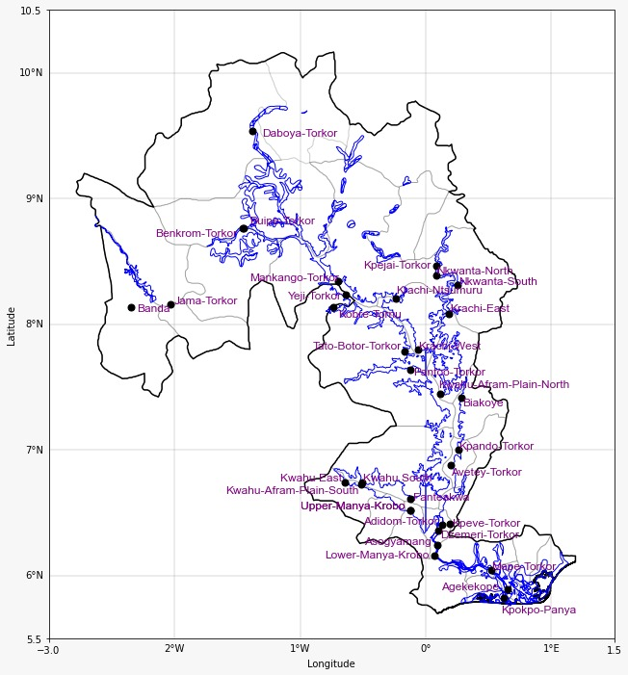
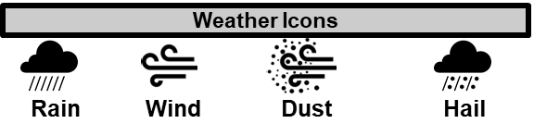
GHANA METEOROLOGICAL AGENCY
P. O. Box LG 87, Accra
Tel: +233-302-543252 / 307010019
Digital Address: GA-485-3581
Email: info@meteo.gov.gh
Website: www.meteo.gov.gh
Twitter:@GhanaMet
Facebook: Ghana Meteorological Agency (GMet)
INLAND WATER IMPACT-BASED FORECAST
WEATHER SUMMARY
Sunny conditions are expected over the lake and its surroundings during the afternoon hours. The southern half is expected to become partly cloudy as evening approaches; however, the prevailing dry and hazy conditions over the northern half are expected to persist throughout the forecast period.
AFTERNOON (21/02/2026) | EVENING (21/02/2026) | MORNING (22/02/2026)
H
H
H
E
H
H
E
H
H
E
G
Date
21/02/2026
Time Issued
10:00 AM
Valid From
12:00 PM
Nowcasting Risk
Take Action
Be aware
Low risk
No risk
Time | Surface Wind | Visibility | Temperature
12 hours | NE/SE 05 Max 20 kt | (5 – 10) km | (23 – 40) ºC
24 hours | W/SW 05 Max 18 kt | (4 – 10) km | (20 – 38) ºC

